Slide 1

Graph Traversal
Presented by:
Elizer Ponio Jr.
Department of Computer Science
College of Computing and Information Technologies

Slide 2
Graph Traversal
Graph search or traversal refers to the process of visiting or checking each vertex in a graph.
Many graph applications need to visit the vertices of a graph in some specific order based on the graph’s topology. This is known as a graph traversal and is similar in concept to a tree traversal.

Slide 3
Graph Traversal
Breadth First Search
Depth First Search

Slide 4
Breadth First Search
Start by putting any one of the graph's vertices at the back of a queue.
Take the front item of the queue and add it to the visited list.
Create a list of that vertex's adjacent nodes. Add the ones which aren't in the visited list to the back of the queue.
Keep repeating steps 2 and 3 until the queue is empty.

Slide 5
Depth First Search
Start by putting any one of the graph's vertices on top of a stack.
Take the top item of the stack and add it to the visited list.
Create a list of that vertex's adjacent nodes. Add the ones which aren't in the visited list to the top of the stack.
Keep repeating steps 2 and 3 until the stack is empty.

Slide 6
Graph Traversal
Visiting a vertex.
Exploring a vertex.

Slide 7







Breadth First Search
Neal
Ronn
Tristan
Jonnah
Nica
J-Rhyzz
Jethro

Slide 8
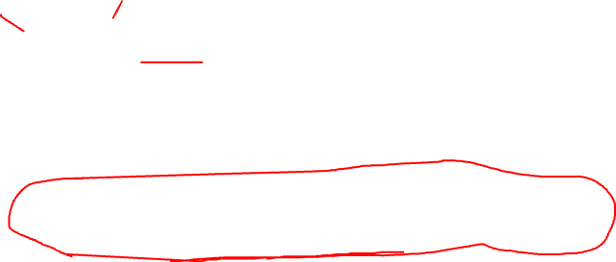
Depth First Search
Stack
Neal
Ronn
Tristan
Jonnah
Nica
J-Rhyzz
Jethro

Slide 9
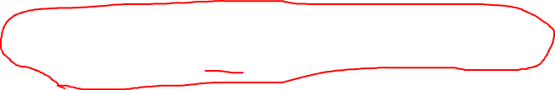
Breadth First Search
Nica
J-Rhyzz
Jethro
Neal
Ronn
Tristan
Jonnah

Slide 10
Depth First Search
Stack
Nica
J-Rhyzz
Jethro
Neal
Ronn
Tristan
Jonnah

Slide 11



Breadth First Search
Winna
Alexander
Nica
J-Rhyzz
Jethro
Kean
Jonnah
Ronn
Queue
Neal
Tristan

Slide 12
Depth First Search
Stack
Alexander
Winna
Nica
J-Rhyzz
Jethro
Kean
Jonnah
Ronn
Neal
Tristan

